Slide 1



Claude for Coding Tasks (Claude Code)
www.zarantech.com
© Copyright 2026, ZaranTech LLC. All rights reserved.

Slide 2


Disclaimer
This presentation, including examples, images, and references are provided for informational purposes only.
Complying with all applicable copyrights laws is the responsibility of the user.
Without limiting the rights under copyright, no part of this document may be reproduced, stored or introduced into a retrieval system, or transmitted in any form or by any means.
Credits shall be given to the images taken from the open-source and cannot be used for promotional activities.
© Copyright 2026, ZaranTech LLC. All rights reserved.

Slide 3

Agenda
Welcome to Module Two focusing on Claude for coding tasks and workflows.
Discover how Claude Code accelerates modern software development and improves project outcomes.
Learn to establish productive workflows for coding, refactoring, and generating thorough documentation.
Master essential techniques to streamline complex coding processes using advanced AI capabilities.
© Copyright 2026, ZaranTech LLC. All rights reserved.

Slide 4

Exercises in This Module
Exercise 4: Create a project context file for Claude Code. 12 minutes.
Exercise 5: Refactor a registration endpoint safely. 20 minutes.
Exercise 6: Add documentation and tests to undocumented code. 22 minutes.
This module needs Claude Code installed locally. No API key yet.
© Copyright 2026, ZaranTech LLC. All rights reserved.

Slide 5
Productive Coding Workflows
Understand the fundamental overview of Claude Code for modern software engineering projects.
Learn how AI-assisted development drastically reduces time spent on repetitive boilerplate coding.
Integrate code-focused workflows directly into your existing development environment with minimal friction.
Unlock higher developer productivity by automating routine project setup and scaffolding tasks.
© Copyright 2026, ZaranTech LLC. All rights reserved.

Slide 6
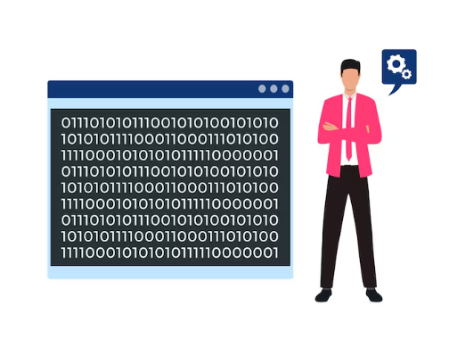
Overview of Claude Code
Claude Code functions as an intelligent partner for your daily complex programming challenges.
It navigates sophisticated codebases quickly to identify potential bugs and logical errors.
Use specialized prompt engineering to extract optimized code solutions from the language model.
Seamlessly transition from basic scripting tasks to designing enterprise-level software architecture systems.
© Copyright 2026, ZaranTech LLC. All rights reserved.

Slide 7
Organizing Project Context
Context organization is critical for ensuring Claude generates accurate and highly relevant code.
Let Claude Code read the repository directly rather than pasting files into a chat.
Avoid overwhelming the model by providing only the strictly necessary files and functions.
Define directory structures clearly so the AI understands your overarching application architecture layout.
© Copyright 2026, ZaranTech LLC. All rights reserved.

Slide 8
The Project Context File
Claude Code reads a CLAUDE.md at your repository root automatically.
Put in it what a new colleague would need: stack, conventions, and what not to touch.
A file beats a pasted message: it survives every session and it is version controlled.
Update it when the design changes, or the assistant keeps building the old shape.
Exercise 4 has you write one for a project of your own.
© Copyright 2026, ZaranTech LLC. All rights reserved.

Slide 9
Effective File Sharing Strategies
Point Claude at the specific files that matter rather than the whole tree.
Use clear and descriptive file naming conventions when passing multiple documents for context.
Highlight specific script line numbers or functions where you want Claude to focus.
Provide sample input and output data alongside your shared codebase for better context.
© Copyright 2026, ZaranTech LLC. All rights reserved.

Slide 10

Giving the Big Picture
Supply architecture notes early to align Claude with your overarching project design patterns.
Share your main README file to establish the core project purpose and dependencies.
Explain your chosen technology stack and framework versions to prevent outdated code suggestions.
Define overarching business logic rules to ensure generated code precisely meets domain requirements.
© Copyright 2026, ZaranTech LLC. All rights reserved.

Slide 11
Context Best Practices
Combine system architecture diagrams with descriptive text to build stronger contextual AI understanding.
Remind Claude of critical security constraints before asking for backend system logic generation.
Explicitly state any strict coding standards or styling guides your development team follows.
Regularly reset the conversation context if the programming topic shifts entirely in direction.
© Copyright 2026, ZaranTech LLC. All rights reserved.

Slide 12
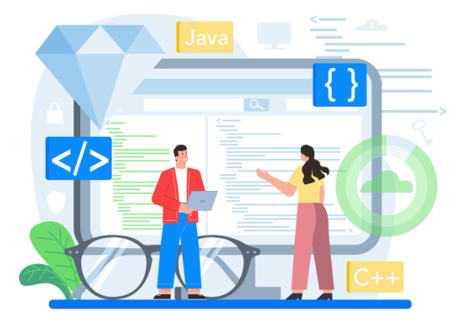
Code Generation and Refactoring
Transition directly from design specifications into highly functional code using AI generation tools.
Explore practical strategies for safely modernizing and refactoring fragile legacy software architecture systems.
Understand the key differences between language-agnostic logic patterns and highly specific syntax features.
Accelerate component creation by translating user stories into ready-to-deploy frontend and backend elements.
© Copyright 2026, ZaranTech LLC. All rights reserved.

Slide 13
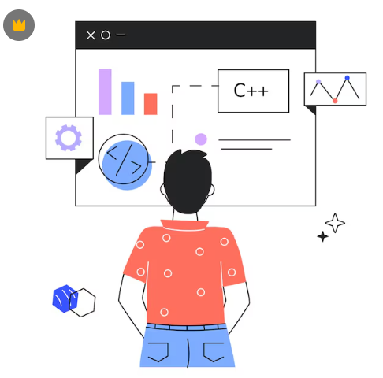
Generating Code from Specs
Paste detailed technical specifications directly into Claude to quickly scaffold new class structures.
Transform plain English user stories into complete and functional software components effortlessly today.
Ask Claude to generate multiple implementation options to choose the best architectural approach.
Provide strict input parameters and expected return types to ensure highly precise generation.
© Copyright 2026, ZaranTech LLC. All rights reserved.

Slide 14

Component Creation Strategies
Break down massive monolithic features into smaller manageable components before requesting AI code.
Generate reusable frontend UI elements by comprehensively describing the desired state and props.
Instruct Claude to include necessary error handling logic during the initial code generation.
Iteratively refine the generated output by providing highly specific feedback on failed tests.
© Copyright 2026, ZaranTech LLC. All rights reserved.

Slide 15

Refactoring Legacy Code
Ask for modernised syntax, and state explicitly what must not change.
Improve overall code readability by requesting better variable naming and logical code grouping.
Extract complex nested conditionals into separate cleaner helper functions for much easier maintenance.
Identify hidden performance bottlenecks and let the AI suggest optimized algorithmic structural alternatives.
© Copyright 2026, ZaranTech LLC. All rights reserved.

Slide 16
Improving Modularization
Deconstruct large monolithic classes into smaller isolated modules following strict single responsibility principles.
Use Claude to map out complicated dependency graphs before beginning extensive refactoring procedures.
Request architectural suggestions to decouple tightly integrated components within your older legacy system.
Ensure backward compatibility while transitioning logic into modern microservice-oriented architectural design patterns.
© Copyright 2026, ZaranTech LLC. All rights reserved.

Slide 17

Implementing Design Patterns
Ask Claude to refactor repetitive code blocks using established structural and behavioral patterns.
Apply the factory or singleton pattern correctly to optimize complex resource management issues.
Translate basic procedural scripts into robust object-oriented systems with clear inheritance hierarchy structures.
Validate that newly applied design patterns align perfectly with your specific project requirements.
© Copyright 2026, ZaranTech LLC. All rights reserved.

Slide 18

Language-Agnostic Patterns
Focus on core algorithmic logic that applies uniformly across multiple different programming languages.
Understand high-level system design concepts before writing complex syntax for a specific framework.
Use simple pseudo-code to design complex business logic with Claude before implementation begins.
Translate core algorithmic logic between different paradigms like functional and object-oriented programming approaches.
© Copyright 2026, ZaranTech LLC. All rights reserved.

Slide 19
Language-Specific Tips
Leverage Python list comprehensions and generators for highly concise and memory-efficient data processing.
Utilize advanced JavaScript asynchronous patterns to handle complex remote API fetching scenarios effectively.
Implement strong typing and interface definitions when generating robust enterprise-level Java server applications.
Ask Claude for language-specific standard library functions instead of writing unnecessary custom utilities.
© Copyright 2026, ZaranTech LLC. All rights reserved.

Slide 20

Documentation and Tests
Automate the creation of comprehensive documentation to keep your development teams perfectly aligned.
Generate extensive unit and integration tests to proactively ensure software reliability and stability.
Learn practical strategies to maintain absolute consistency between deployed code and project documentation.
Reduce developer fatigue by offloading tedious code commenting and testing tasks to AI.
© Copyright 2026, ZaranTech LLC. All rights reserved.

Slide 21
Auto-Generating Documentation
Instantly generate precise docstrings for complex mathematical functions and highly intricate business logic.
Produce helpful inline code comments that thoroughly explain reasoning behind complex algorithmic choices.
Draft structured README sections detailing required installation steps and critical configuration requirements.
Create comprehensive API reference documentation based on your newly defined routing architecture files.
© Copyright 2026, ZaranTech LLC. All rights reserved.

Slide 22

Structuring the README
Instruct Claude to systematically organize your README with clear prerequisites and deployment instructions.
Automatically extract package dependencies from configuration files to generate accurate environment setup guides.
Draft highly engaging project overviews that help new contributors completely understand the mission.
Generate incredibly clear troubleshooting sections based on common syntax errors found during development.
© Copyright 2026, ZaranTech LLC. All rights reserved.

Slide 23

Generating Unit Tests
Submit complex individual functions to Claude to generate incredibly comprehensive and isolated tests.
Ensure tests proactively cover standard inputs alongside unexpected edge cases and boundary conditions.
Generate automated mock objects to easily simulate external database connections or API responses.
Specify your preferred modern testing framework like PyTest or Jest for accurate syntax.
© Copyright 2026, ZaranTech LLC. All rights reserved.

Slide 24
Generating Integration Tests
Design robust integration tests that verify critical interactions between multiple independent software modules.
Verify that specific API endpoints correctly process web requests and update database records.
Ask Claude to intelligently simulate complex user flows directly through your frontend components.
Generate automated setup and teardown scripts to consistently maintain a clean testing environment.
© Copyright 2026, ZaranTech LLC. All rights reserved.

Slide 25
Maintaining Consistency
Regularly feed updated source code back into Claude to accurately refresh outdated documentation.
Implement automated verification checks to ensure that text comments match underlying function logic.
Ensure that generated software test cases accurately reflect the latest agile story requirements.
Create synchronized workflows where source code changes immediately trigger targeted documentation update prompts.
© Copyright 2026, ZaranTech LLC. All rights reserved.

Slide 26

Key Takeaways
Established highly effective workflows by correctly organizing context and sharing the big picture.
Generated entirely new software components and expertly refactored legacy code using AI techniques.
Applied both language-agnostic foundational logic and language-specific framework features to optimize performance.
Automated comprehensive project documentation and rigorous testing to maintain high-quality coding standards.
© Copyright 2026, ZaranTech LLC. All rights reserved.

Slide 27
Thank You
For more informative Videos, Subscribe to our YouTube Channel
www.zarantech.com
© Copyright 2026, ZaranTech LLC. All rights reserved.

